Slide 1
Factor Models & Neural Networks
Application to Finance

Slide 2
Robust Factor Based Investing
Summary: a survey of studies on robust methods for factor-based investing.
Methods
RFM is a separable model
defines separate uncertainty sets for different components of the factor model
1. Mean return vector µ (componentwise interval uncertainty set)
2. Factor-loading matrix V (elliptical uncertainty set)
3. Covariance matrix D (componentwise interval uncertainty set)
Six Factor Model
used for estimating expected returns of various asset classes
Metrics
Alpha alignment factor
Conclusion
Returns of the Fama–French three factors.
Robust portfolios = higher factor dependency than classical mean–variance portfolios under various conditions.

Slide 3
Impact of Factor Models on Portfolio Risk Measures: A Structural Approach
Summary: impact of lower tail dependence on the frontier of a credit portfolio, and on the optimal VaR and allocation for various models
Gaussian factor model = portfolios with a misleading optimal risk–return trade-off
Methods
Gaussian Model
Normal Inverse Gaussian Model (NIG)
Simple Student T Factor Model
Double Student T Factor Model
Metrics
Pearson Correlation
Conclusion
Double, Simple Student t and the NIG factor model rise faster with an increasing return restriction than Gaussian factor model
Gaussian model therefore underestimates the VaR of the portfolio

Slide 4
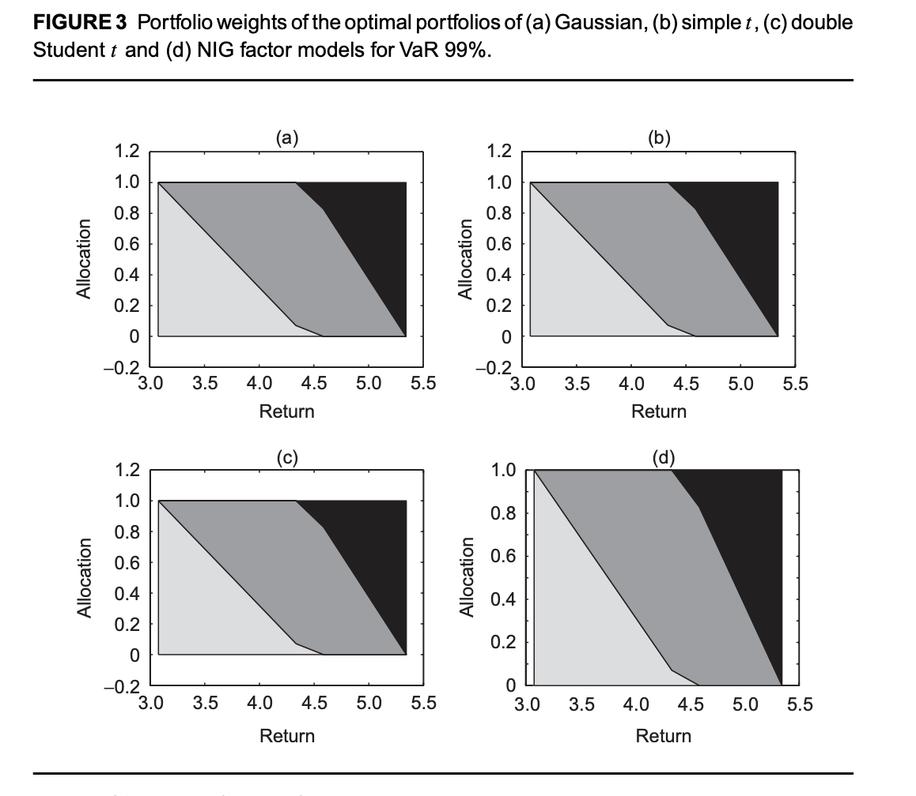

Slide 5
Prediction Based Portfolio Optimization based on Neural Networks
Summary: neural network predictors to predict stocks’ returns and derived a risk measure
Have the same foundation of the mean-variance model
Methods/Metrics:
Autoregressive Moving Reference Neural Network Predictors (AR-MRNN)
Experiment using Brazilian Stock Market
Root Mean Square Error
Conclusion
prediction-based portfolio optimization model outperforms the mean-variance model
higher returns with lower risks using same stocks (See next slide)
returns 291% above the mean-variance model, with similar levels of risk.

Slide 6
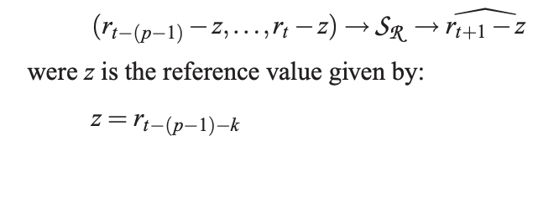
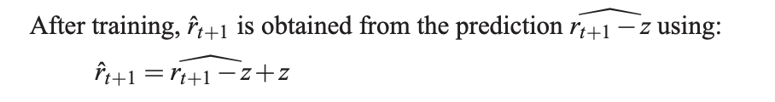
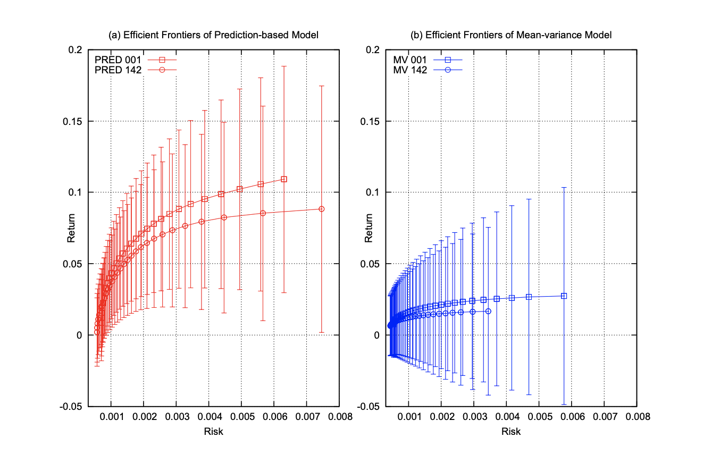
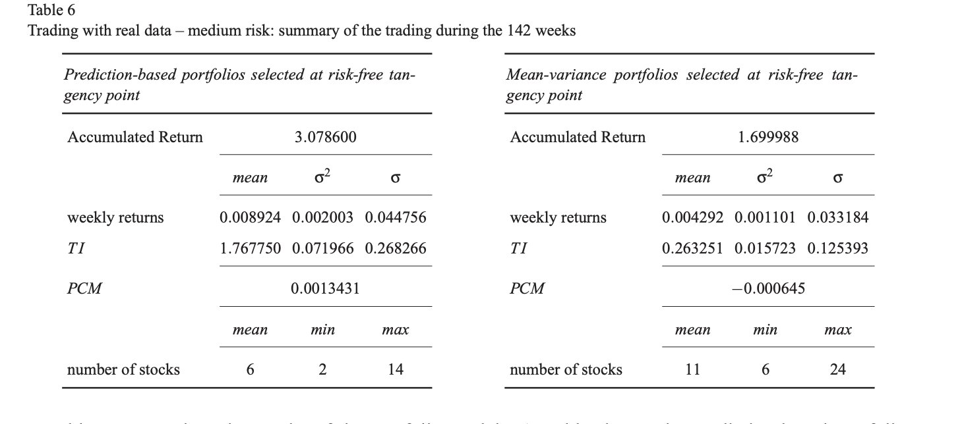
AR-MRNN

Slide 7
Possible Topics to Look More Into
Alpha Alignment Factor
Autoregressive Moving Reference Neural Network Predictors
Normal Inverse Gaussian Model
Notes:
Further research How to implement Prediction Based Portfolio Optimization and Neural Networks in Python

